Slide 1
Date : 2013/05/27
Author : Anish Das Sarma , Lujun Fang , Nitin Gupta , Alon Halevy,
Hongrae Lee , Fei Wu , Reynold Xin , Gong Yu
Source : SIGMOD’12
Speaker : Er-Gang Liu
Advisor : Prof. Jia-Ling Koh

Slide 2
Outline
Introduction
Entity Complement
Entity Consistency and Expansion
Schema Similarity
Schema Complement
Coverage of entity set
Benefits of additional attributes
Experiment
Conclusion

Slide 3
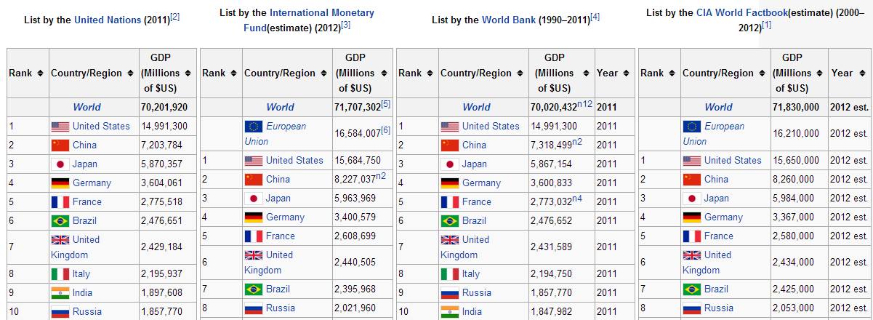
Introduction - Motivation
Web Tables
Web consists of a huge number of document
Apply an HTML parser to a page crawl to obtain billion instances of the <table> tag
Large amount of HTML tables containing relational-style data and schema-like descriptions
http://en.wikipedia.org/wiki/List_of_countries_by_GDP_(nominal)

Slide 4
Introduction - Motivation
Structured data comes in many forms. focusing on HTML tables for this paper.
Searching related tables (identify “good” relations)
What does “related” really mean?
What is the similarity function? (note: tables are semi-­‐structured)

Slide 5
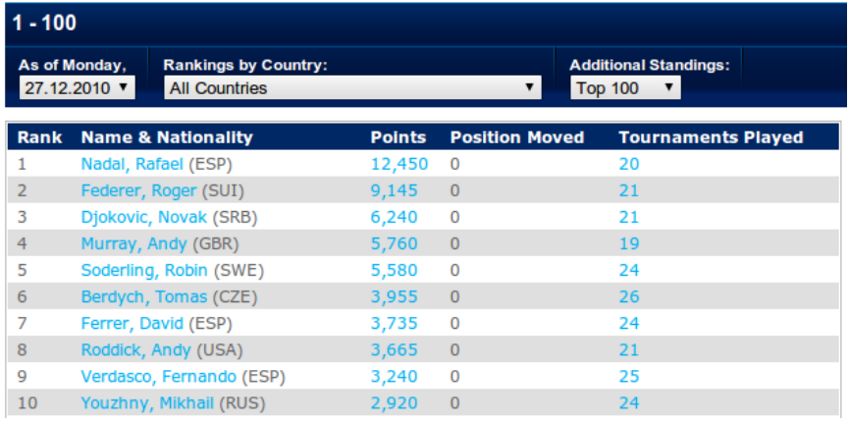
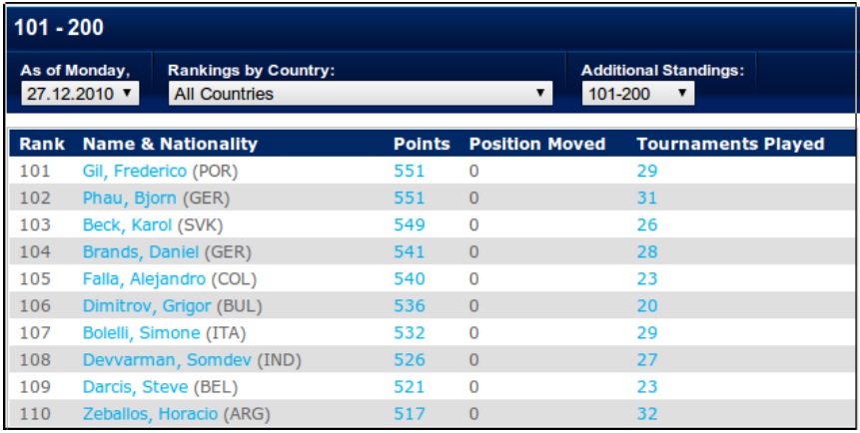
Introduction - Motivation
A: Top 100 Tennis Players in 2010
B: Players Ranked 101-200 in 2010
We can union Tables A and B.
Their schema is identical, and they provide complementary sets of entities

Slide 6
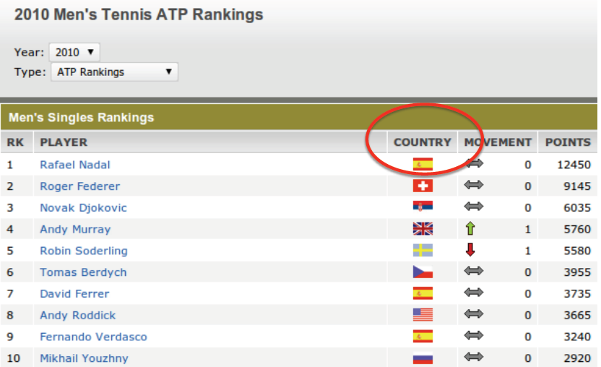
Introduction - Motivation
A: Top 100 Tennis Players in 2010
C : Top 100 in 2010 : ATP Ranking
We can join Tables C with Table A.
The two tables describe the same entities, but the table in Figure A adds more information (Tournaments Played )

Slide 7
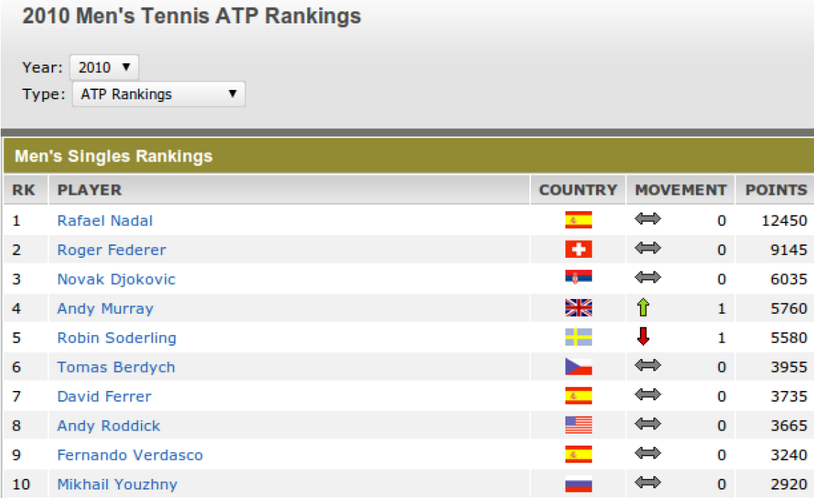
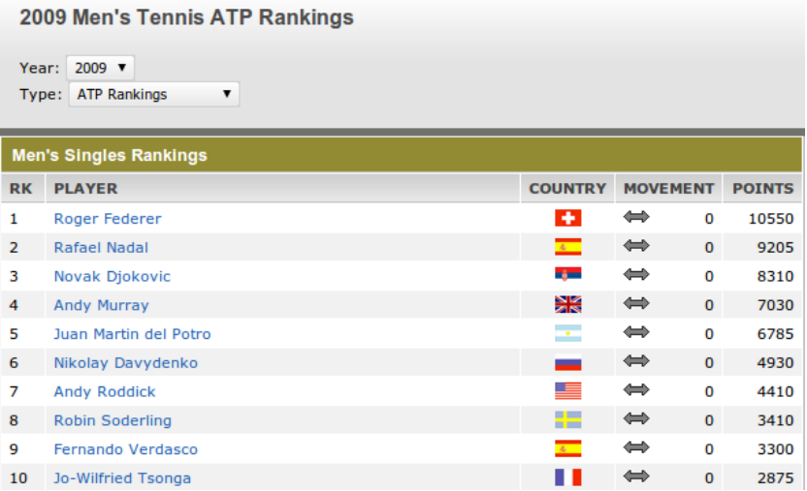
Introduction - Motivation
C : Top 100 in 2010 : ATP Ranking
D : Top 100 in 2009 : ATP Ranking
Can’t directly joined or union D with C.
They both can be seen as the result of a selection and projection on a larger table that contains the rankings of tennis players in different years.

Slide 8
Introduction - Goal
Describes a framework for defining relatedness of tables and algorithms for finding related tables.
Given a table T, return a ranked list of tables that are related to T.
If table T’ is related to T that is high in the search result ranking, T’ could also be good and relevant.
Tables can be related in various ways:
Joinable, unionable, fragments of one table

Slide 9
Outline
Introduction
Entity Complement
Entity Consistency and Expansion
Schema Similarity
Schema Complement
Coverage of entity set
Benefits of additional attributes
Experiment
Conclusion

Slide 10
Entity Complement
Entity Consistency (Coherence)
Entity Expansion (Substantially add new entities)
Schema Consistency (Similar Schema)

Slide 11
Entity Complement - Sources of signal
Constructing a single measure for the relatedness of two tables’ (T1 and T2’s) entity sets
E(T1) = { India, Korea, Malaysia }
E(T2) = { Japan , Taiwan}
This paper infer entity groups based on several signals can mine from the Web:
WeblsA database
Freebase types
Table co-occurrence
EX: E(T2) = { Taiwan }
L(Taiwan) = { Asian countries , developed countries , ……. }
Notes:
http://freebase-search.freebaseapps.com/?query=&filter=(all+type%3A%2Flocation%2Fcitytown+%2Flocation%2Flocation%2Fcontainedby.in%3Aislands+(any+%2Flocation%2Flocation%2Fcontainedby%3Aeurope+%2Flocation%2Flocation%2Fcontainedby%3Aasia))&output=((part_of+(filter+(any+type%3A%2Fgeography%2Fisland+type%3A%2Flocation%2Fcountry))))

Slide 12
Outline
Introduction
Entity Complement
Entity Consistency and Expansion
Schema Similarity
Schema Complement
Coverage of entity set
Benefits of additional attributes
Experiment
Conclusion

Slide 13
Entity Consistency and Expansion
Entity Set
E(T1) = { India, Korea, Malaysia }
E(T2) = { Japan, Taiwan }
Relatedness between entity sets
Entity sets E(T1)
Entity sets E(T2)
Relatedness between a pair of entities
L(India) = { Asian countries , developing country , location , cricket ……. }
L(Japan) = { Asian countries , developed countries , location , baseball ……. }

Slide 14
Relatedness between a pair of entities
E(T1) = { India, Korea, Malaysia }
E(T2) = { Japan, Taiwan}
L(Japan) = { Asian countries :1, developed countries:1 , location:1 , baseball:1 ……. }
L(India) = { Asian countries :1, developing country:1 , location:1 , cricket:1 ……. }
L(Korea) = { Asian countries:1 , developed countries:1 , location :1, baseball:1 ……. }
reu(India,Japan) = 2
reu(Korea,Japan) = 4

Slide 15
Relatedness between entity sets – aggregate relatedness
E(T1) = { India, Korea, Malaysia }
E(T2) = { Japan, Taiwan }
$\frac{1}{3∗2}$ (re(India,Japan) + re(Korea,Japan) + re(Malaysia, Japan) +
re(India, Taiwan) + re(Korea,Taiwan) + re(Malaysia, Taiwan) )
$\frac{1}{3}$ (re(India,Japan) + re(Korea,Japan) + re(Malaysia, Japan) +
re(India, Taiwan) + re(Korea,Taiwan) + re(Malaysia, Taiwan) )

Slide 16
Relatedness between entity sets – sets of entities
E(T1) = { India, Korea, Malaysia }
E(T2) = { Japan , Taiwan }
L( E(T1) ) = { Asian countries:3 , developed countries:2 , developing:1 country :1,baseball:1 , cricket :1,soccer:1……. }
L( E(T2) ) = { Asian countries:2 , developed countries:2 , soccer:1 , baseball:2 , ……. }
the parameters are set to m1 = n1 = m2 = n2 = 2.0
= $\frac{{(w\left(India , Asian countries +w(Korea , Asian countries+w (Malaysia , Asian countries \right)+…)}^{2}}{{E(T1)}^{2}}$

Slide 17
Outline
Introduction
Entity Complement
Entity Consistency and Expansion
Schema Similarity
Schema Complement
Coverage of entity set
Benefits of additional attributes
Experiment
Conclusion

Slide 18
Schema Similarity
Computing the schema similarity between the query table T1 and a candidate related table T2, denoted SSS(T1, T2).
The set of labels and attribute name on each table to representing string similarity (Jaccard Similarity)
A1-1 A1-2 A1-3 A1-4 A1-5
T1
T2
A2-1 A2-2 A2-3 A2-4 A2-5
= $\frac{W}{5+5−4}$
ni = number of attribute of Ti
N = the number of attribute in the matching
W = weight of this matching

Slide 19
Outline
Introduction
Entity Complement
Entity Consistency and Expansion
Schema Similarity
Schema Complement
Coverage of entity set
Benefits of additional attributes
Experiment
Conclusion

Slide 20
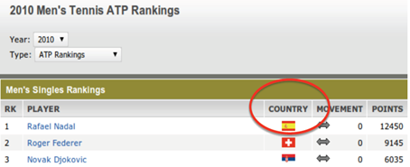
Schema Complement
Given a table T1, we are interested in finding tables T2 that provide the best set of additional columns.
Adding as many properties as possible to the entities in T1 while preserving the “consistency” of its schema.
This Paper consider the following factors:
Coverage of entity set
Benefits of additional attributes

Slide 21
Outline
Introduction
Entity Complement
Entity Consistency and Expansion
Schema Similarity
Schema Complement
Coverage of entity set
Benefits of additional attributes
Experiment
Conclusion

Slide 22
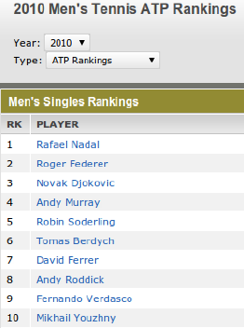
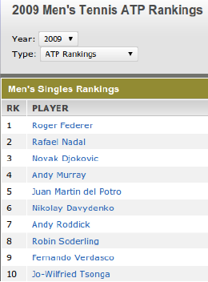
Schema Complement - Coverage of entity set
T2 should consist of most of the entities in T1, if not all of them
Compute the coverage of T2’s entity set with respect to T1
= $\frac{7}{10}$

Slide 23
Outline
Introduction
Entity Complement
Entity Consistency and Expansion
Schema Similarity
Schema Complement
Coverage of entity set
Benefits of additional attributes
Experiment
Conclusion

Slide 24
Schema Complement - Benefits of additional attributes
T2 should contain additional attributes that are not described by T1’s schema.
Using S(Ti) to denote the set of attributes in Ti and S(T2) \ S(T1) to represent the additional attributes in T2’s schema.
A baseline measure for the benefit of T2 simply counts the number of additional attributes:
A1-1 A1-2 A1-3 A1-4 A1-5
T1
T2
A2-1 A2-2 A2-3 A2-4 A2-5
= 1

Slide 25
Schema Complement - Benefits of additional attributes
AcsDB , a data structure that summarizes the frequencies of all possible schemas in the Web table corpus.
Given a set of attributes S, the AcsDB provides the frequency, freq(S), of S in the table corpus.
Assume:
freq( S(T1) ) = freq( id,name) = 20
freq( {age} U S(T1) ) = freq( {age} U {id , name} ) = 8
= $\frac{8}{20}$
The freq(S) in AcsDB is not as meaningful for large schema because they appear very few times in the web table corpus.

Slide 26
Schema Complement - Benefits of additional attributes
A more effective measure is to derive the benefit measure by considering co-occurrence of pairs of attributes, rather than the entire schemas.
Determining the consistency of a new attribute a2 to an existing attribute a1, denotedy by cs(a1, a2), using AcsDB schema
Assume:
freq( id ) = 10
freq( id, age ) = 4
T1
T2
id , name
cs(id , age)= $\frac{freq(id, age)}{freq(id)}$ = $\frac{4}{10}$
id ,name, age
cs(S(T1) , age) = $\frac{1}{2} ( \text{cs}\text{( }\text{id}\text{, }\text{age}\text{)}$ + $\text{cs}\text{( }\text{name}\text{,} \text{age}\text{)}$ )

Slide 27
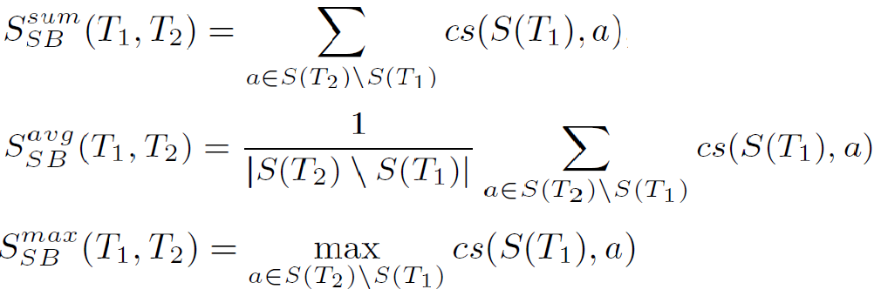
Schema Complement - Benefits of additional attributes
Considering three kinds of aggregation:
sum (giving importance to the amount of extension)
average (normalizing the total extension by the number of new attributes)
max (considering the most consistent attribute as representative)

Slide 28
Outline
Introduction
Entity Complement
Entity Consistency and Expansion
Schema Similarity
Schema Complement
Coverage of entity set
Benefits of additional attributes
Experiment
Conclusion

Slide 29
Experiment
Experimental setup:
This paper evaluated the relatedness algorithms on 18 queries.
Generate top-5 related tables for the query table
Results are based on aggregating the feedback of 8 users.
Metric:
For each query table, we generate top-k (k = 1 to 5) related tables based on it
Each user to provide a score from 0 to 5 indicating how closely T2 is related to T1 with respect to R (0 being not related and 5 being most related).

Slide 30
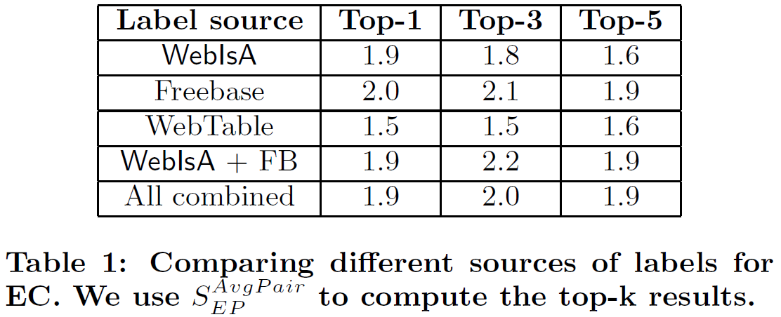
Experiment - Entity Complement Results
Freebase labels are most effective if we consider only one source of labels.
Interestingly, adding WebIsA and WebTable labels does not have an apparent impact.

Slide 31
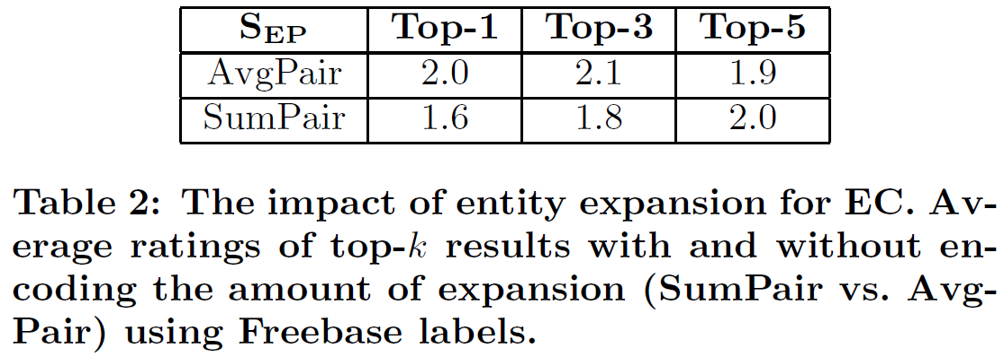
Experiment - Entity Complement Results
The measure AvgPair , which rewards consistency over entity-set expansion is significantly better (up to 25% improvement) compared with SumPair

Slide 32
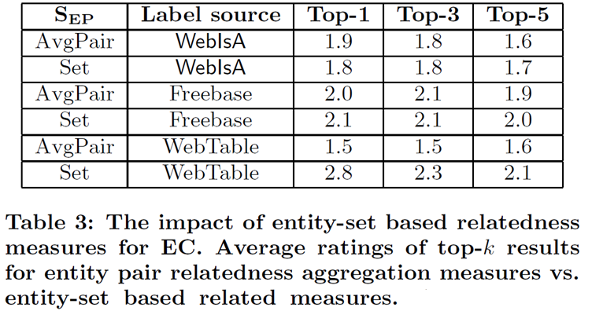
Experiment
The best result combines set-based relatedness with labels from WebTable

Slide 33
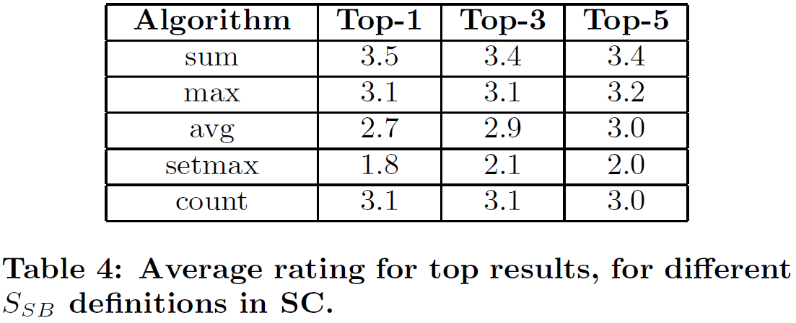
Experiment – Schema Complement Results
sum achieves the best results, while max and count also perform reasonably well.
Sum aggregation is the most effective, and it indicates that when considering schema complement
Users indeed focus on the number of additional attributes

Slide 34
Outline
Introduction
Entity Complement
Entity Consistency and Expansion
Schema Similarity
Schema Complement
Coverage of entity set
Benefits of additional attributes
Experiment
Conclusion

Slide 35
Conclusion
This paper introduced the problem of finding related tables from a large heterogeneous corpus that are related to an input table.
Presenting a framework that captures a multitude of relatedness types, and described algorithms for ranking tables based on entity complement and schema complement
Describing user studies that evaluated the quality of our related tables detection algorithms, and showed how related tables discovery may enhance table search results

